Slide 1
B-Safe
Student Safety App

Slide 2
App Idea
This is an application where we can share our location to police and our designated emergency contacts when we feel unsafe and provide emergency contact details. This app will be more helpful for students who travel out of college circumstances where we do not have emergency buttons, during the nights after their classes especially who go by walk or bicycle.
< /
>
http://
Target users Students

Slide 3





Three Screens
Home Screen
Profile Screen
Sign up screen Emergency contacts screen
App Requirements
Database
Room data base
Gesture Detection Tap on alert button
Device Sensors
Location Sharing
Background Work
Sending SMS

Slide 4
Work Division
1. Screens are divided among the team members 2. Each team member is responsible for development of each screen including the front end, coding logic and interacting with data base. 3. The idea behind this is every team member should know about every aspect in the mobile application development

Slide 5
APPLICATION SCREEN FEATURES
Home Screen
Emergency Alert Button
Sign-up Screen
Profile Screen
Allows user to sign up to the app by providing his personal info and provide emergency contacts
Allows user to navigate to his personal details and edit them
Allows user to edit emergency contact details , edit his profile, activate emergency alert
It’s part of home screen where there is an alert button which upon emergency is clickable

Slide 6
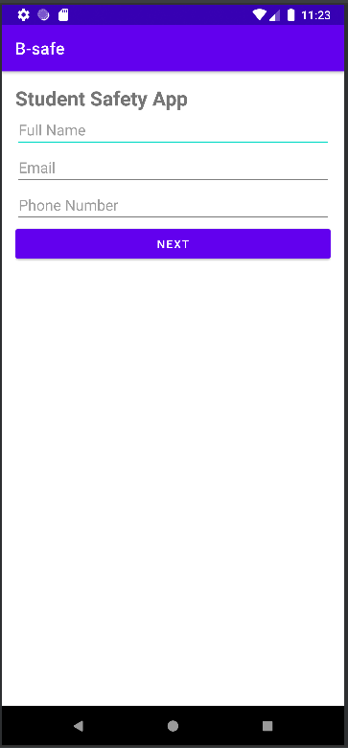
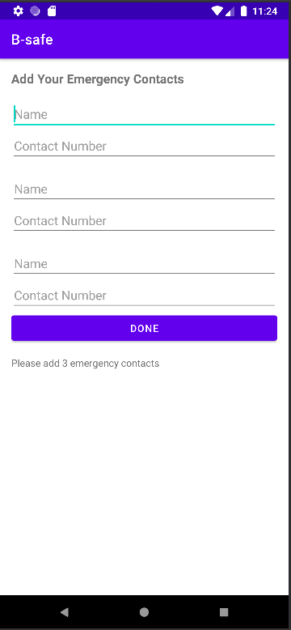
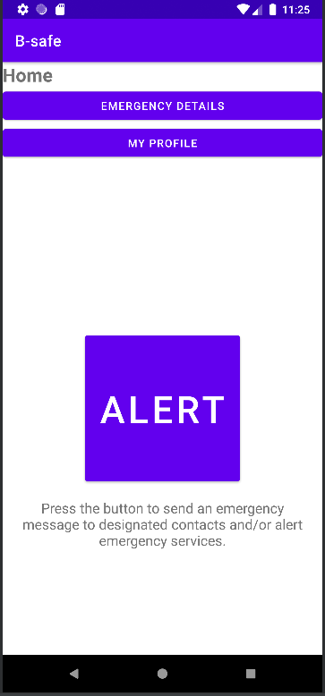
Demo of Screens

Slide 7
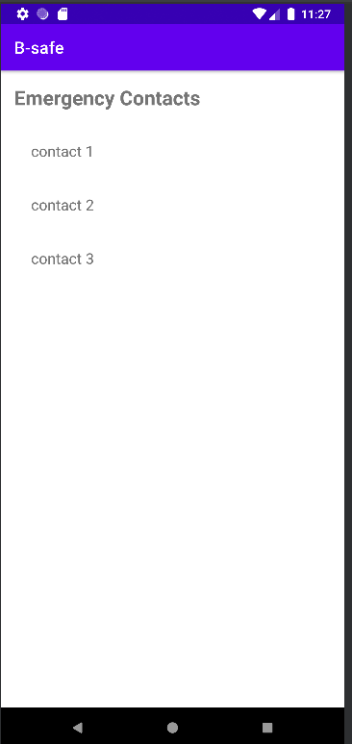
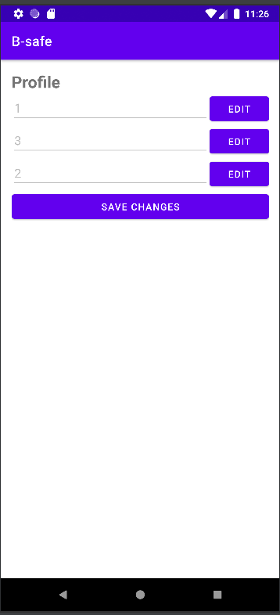
Demo of Screens

Slide 8
Changes from Beginning to End of Project
Complex design.
Simple design
Vs
Lots of Screens and repeated logins.
Before
Now
Reduced Screens
Not User friendly.
User friendly

Slide 9
Design Challenges
Live Location Sharing
SMS to the emergency contacts of the users

Slide 10
Solutions to Challenges
We referred to some of the online repositories where the location and SMS services are implemented and tried to modify and implement them as per our project requirements out of which few worked.

Slide 11
App Demo

Slide 12
THANK
YOU

